Slide 1
Restaurant Recommendation system using Machine learning
Guided by:
Prof. U. A. Nuli

Slide 2
Group members
Kamble Hema
Karvekar Vrushali
Ghatage Rutuja
Tezad Komal
15CMPN17
15CMPN21
16MHTRCMPN67
16DSCMPN11

Slide 3
Overview
Introduction
Related work
Problem Statement
Objectives
Scope
System architecture
Methodology
Functional Requirements
Design Constraints
Software design diagrams
References

Slide 4
Introduction
The recommendation system is widely used in various fields such as health, travel, eateries, etc.
Machine learning uses statistical techniques to give computers the ability to “learn” with data, without being explicitly programmed
This project implements machine learning algorithm for restaurant recommendation system.
The underlying assumption of the collaborative filtering approach is that if a person A has the same opinion as a person B on an issue, A is more likely to have B's opinion on a different issue than that of a randomly chosen person

Slide 5
Related work
Wei-Ta Chu, Ya-Lun Tsai, 2017, proposed a hybrid recommendation system by combining content based approach and collaborative filtering approach
A Jayasimhan, P Rai, Y Parekh, O Patwardhan, 2017, proposed a recommendation system for restaurants using open source dataset and applying machine learning techniques and algorithms
Badrul Sarwar, George Karypis, Joseph Konstan, and John Riedl, 2001, proposed analysis of different item-based recommendation generation algorithms.
Prem Melville and Raymond J. Mooney and Ramadass Nagarajan, 2002, proposed Content-Boosted Collaborative Filtering for Improved Recommendations

Slide 6
Problem Statement
To develop restaurant recommendation system using collaborative filtering algorithm
By developing a recommendation system which could help a user to decide which restaurant one should visit, the person can save a lot of his time, efforts and money and thus have a great experience and satisfaction

Slide 7
Objectives
To display list of restaurant as per the users choice.
To develop user friendly system that can recommend list of restaurant as per the choice and mood of the user.

Slide 8
Scope
The restaurant recommendation system is basically the recommendation system so that users can provide the login id as input and get the best suitable restaurant according to the ratings.
The project is specifically designed for the use of consumers who like to visit the restaurants. The product will work as a complete user interface for restaurant recommendation process and restaurant usage from ordinary users.
The restaurant recommendation system can work as powerful recommendation system for large area

Slide 9
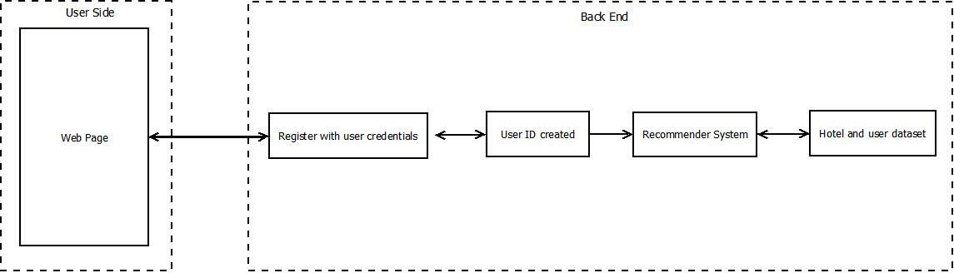
System architecture

Slide 10
Algorithmic description
Go to web page
Log in with user credentials
if not register, signup
Login with user id
Implement collaborative algorithm
Display Restaurant List as per the recommendation system

Slide 11
Methodology
Web page
The user register using username and password
The user will login using system generated user id
The list of top 10 restaurants will be provided with ratings

Slide 12
Methodology
Collaborative Method
Store user id from web page in ‘pythonID.txt’
Let r_{x} be vector of user x’s rating
Use KNN basic algorithm to find neighbors of user for which we are recommending restaurant
Use the cosine similarity method
Fit the train set to compute similarity
Arrange neighbors in descending order of their similarity
Choose 10 most similar users to user x.
Cancel x-to-x similarity score.

Slide 13
Methodology
Recommender
The prediction calculates similarity between each user and then based on each similarity calculates prediction
Using the formula, the prediction P_{u,i}is given by
P_{u,I} = Σ_{v} (r_{v,i}*s_{u,v}) / Σ_{v} s_{u,v}
Recommend top 10 restaurants by deleting the visited restaurants.
Write result in ‘output.txt’ and send it to web page.

Slide 14
Functional Requirements
The project contains following functional requirements
User registration
Login
Restaurant Display as per user’s choices.

Slide 15
Design constraints
Windows version; The application cannot run below 7
RAM - more than 4 GB.
Space on disk is 3-4 MB.

Slide 16
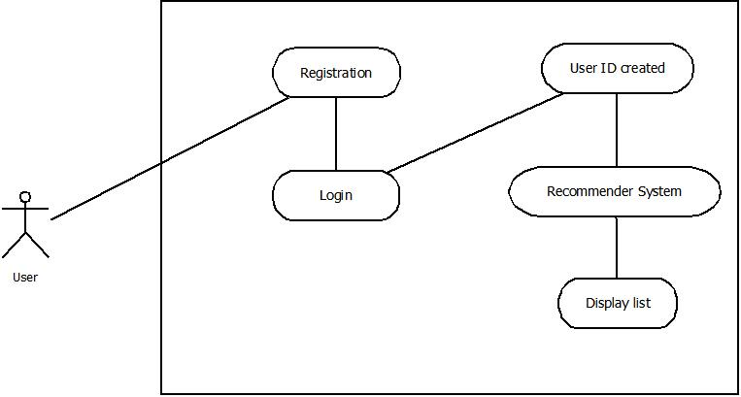
User interface diagram

Slide 17
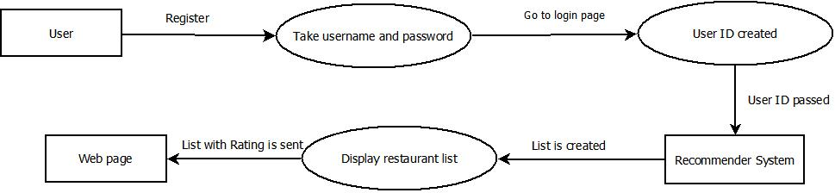
Data flow diagram

Slide 18
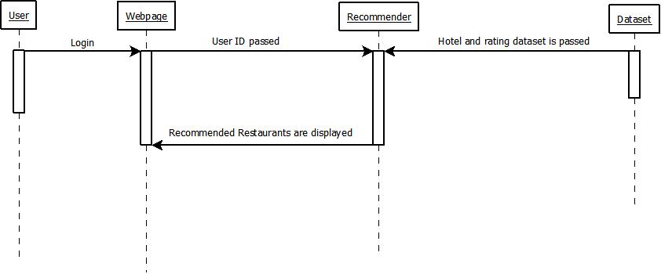
Sequence diagram

Slide 19
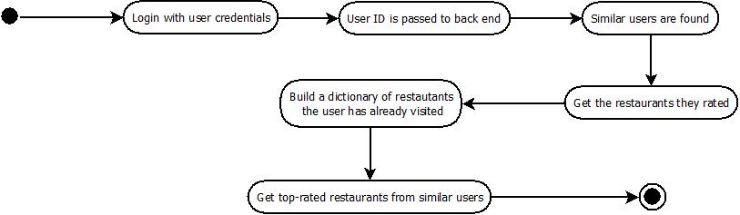
Activity diagram

Slide 20
Applications
Real time implementation with the help of map
The proposed system will guide the user, by plotting the paths on the map to the recommended location. It will also point to the favorite restaurant in a nearby area. The map can be used for the same. The web provides wide varieties of services for user to embed into website.
Tourism or hotel booking system or shopping
This system can also be useful for tourism as well as for hotel booking. This system can be proposed for the user based on preference transaction network when a user selects hotels. The proposed system is available for repeatable purchases without explicit product evaluation.

Slide 21
References
Wei-Ta Chu, Ya-Lun Tsai, “A hybrid recommendation system considering visual information for predicting favourite restaurants”, World Wide Web DOI 10.1007/s11280-017-0437-1, January 2017
A Jayasimhan, P Rai, Y Parekh, O Patwardhan, “Recommendation System for Restaurants”, International Journal of Computer Applications (0975-8887), Volume 167-No.6, June 2017.
Badrul Sarwar, George Karypis, Joseph Konstan, and John Riedl, “Item-based Collaborative Filtering Recommendation Algorithms” , WWW10, May 1-5, 2001, Hong Kong.
Prem Melville and Raymond J. Mooney and RamadassNagarajan. “Content-Boosted Collaborative Filtering for Improved Recommendations”, Proceedings of the Eighteenth National Conference on Artificial Intelligence(AAAI-2002), pp. 187-192, Edmonton, Canada, July 2002

